Slide 1
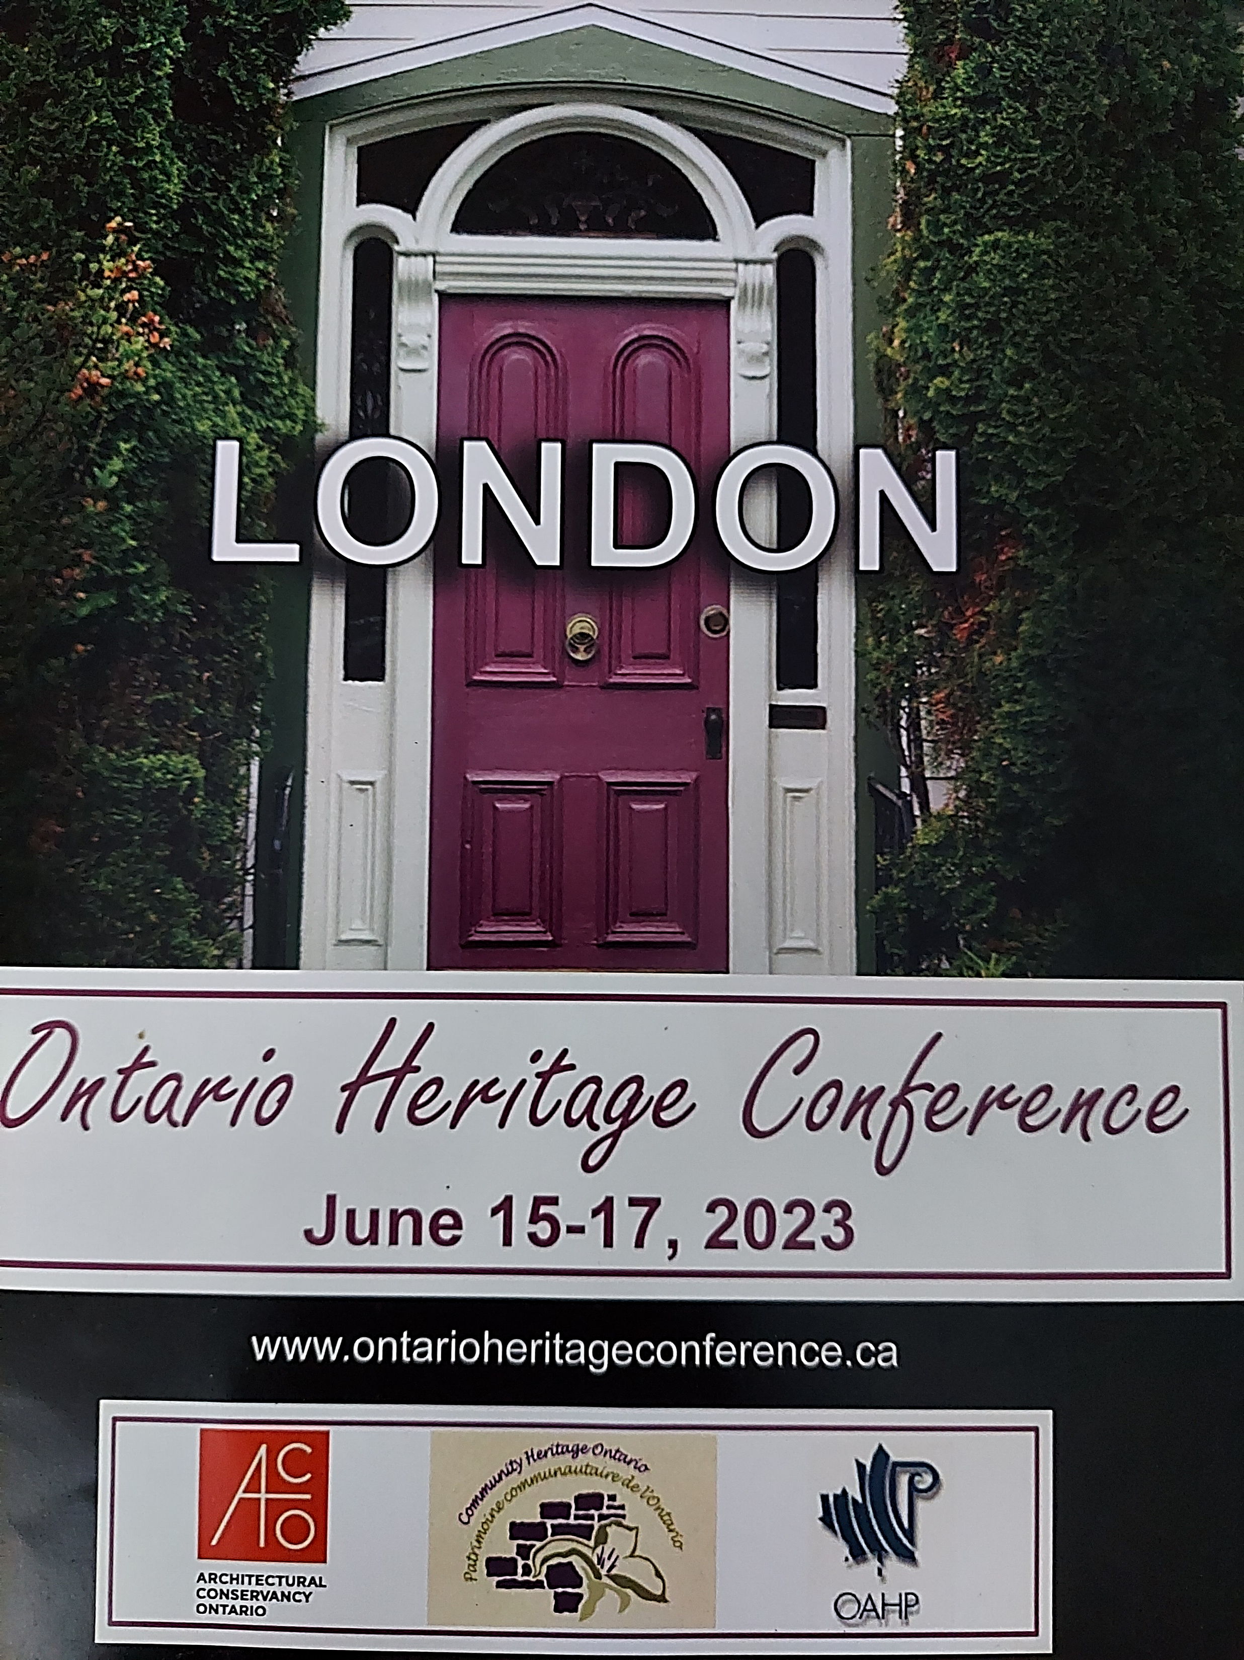
Review of Conference
Puslinch Heritage Committee
September 11, 2023
Lily Klammer

Slide 2
Conference Organizers and Attendees
Organizers from City of London planning, University professor, Architectural Conservancy Ontario (ACO)
Great attendance with over 200 Delegates (usually 150-200)
Heritage planners,
Councillors,
Consultants,
ACO members,
Municipal heritage committee members,
Architects, and
Practitioners

Slide 3
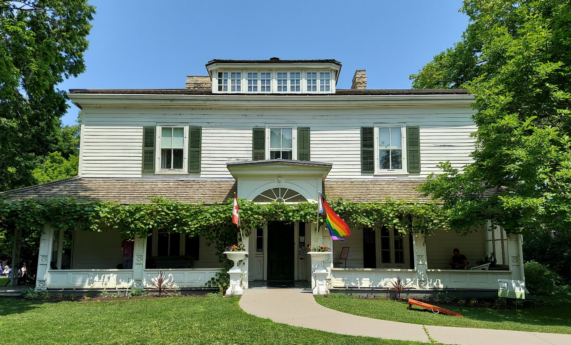
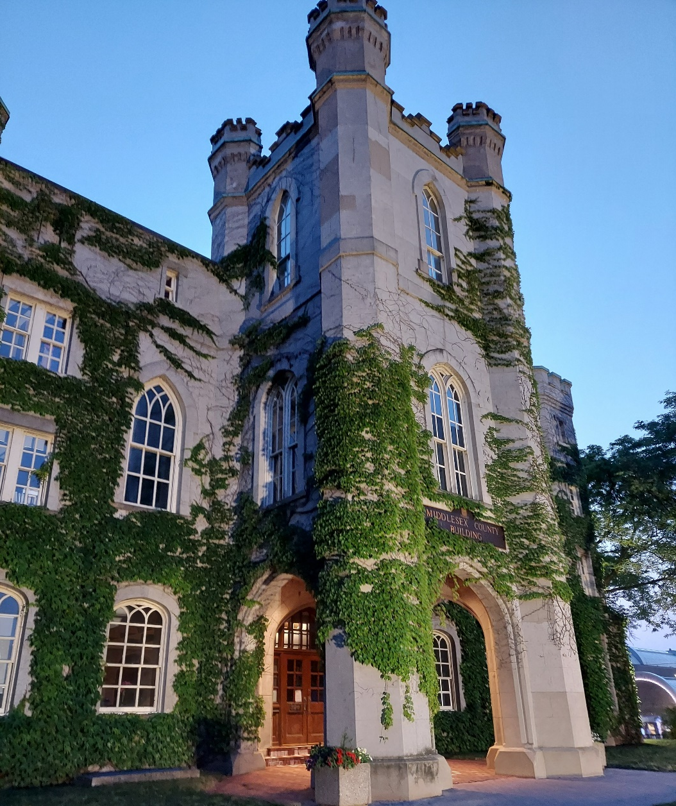
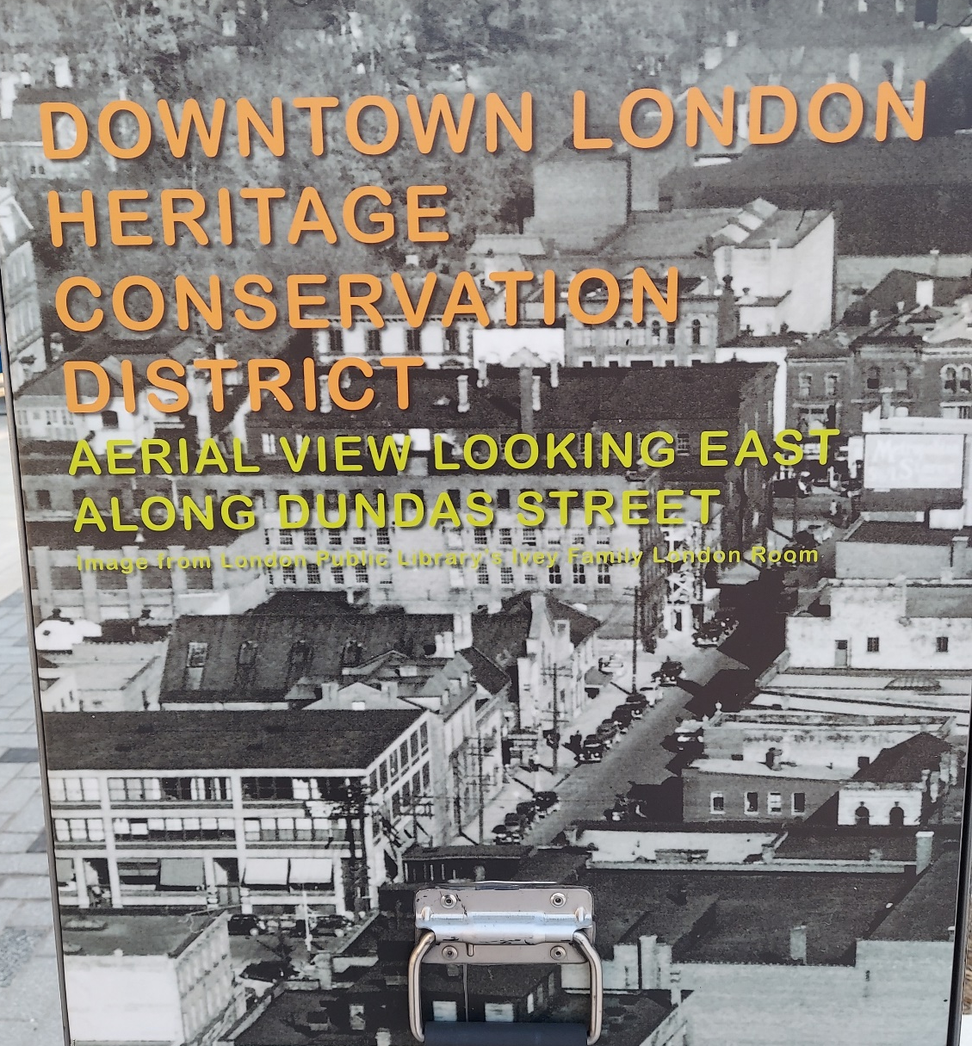
Venue – City of London, ON UNESCO City of Music
Elden house 1834
Historic Pub – Crawl
Chaucer’s 1854
The Old Courthouse
circa 1827
Walking through historical districts

Slide 4
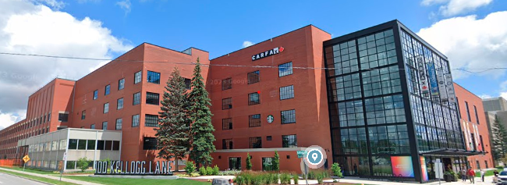
100 Kellogg Lane - Adaptive Reuse www.100kellogglane.com
Kellogg cereal factory 1924 - 2014
An artisan "Maker's Market“, Outdoor markets
A boutique hotel, Convention centre, Office space, Restaurants
Hard Rock Hotel
A versatile record-breaking adventure park:
The Factory, The Club House

Slide 5
Hear, Here London www.hearherelondon.org
Interactive community messaging / touring
Street level signs with phone number
Oral history – recordings, > 60 stories currently
Automated first person narrative(s) story of that location
Two minute time limit to retain interest
Can also navigate/hear the stories through the Website map
Involvement for the initiative
Town (permission for signs),
Library (houses the stories and materials)
Guelph Arboretum – NEW - about 15 stories now – QR Codes
Initial Hear, Here from Wisconsin, some fees involved

Slide 6
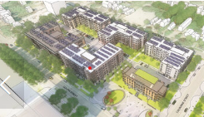
The Vision SoHo Alliance Project
Decommisioned Victoria hospital site in London’s South of Horton (SOHO) neighbourhood (built 1875)
Project with six non-profits, seven different projects for the seven buildings
Involves converting two heritage buildings and building five new apartment buildings – 138 Suites of affordable housing heritage, >275 overall new units
Discussion of the two heritage conversions:
Indwell & Invizij Architects Inc.
Adaptive Reuse costs less than new construction
Condition of the two buildings
vacant, neglected, water damage

Slide 7
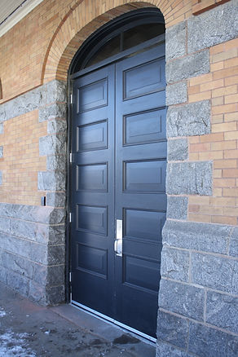
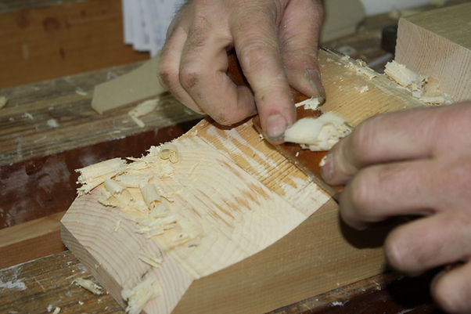
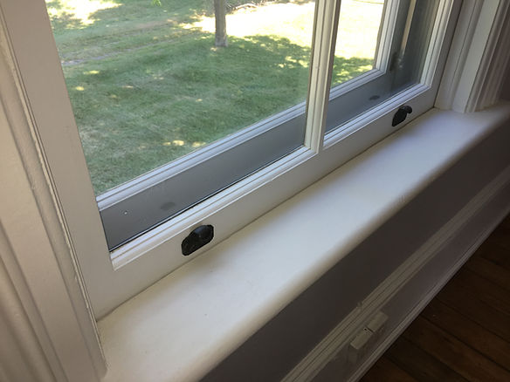
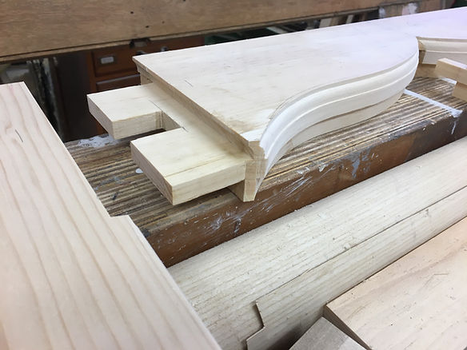
Discourse of Traditional Front Porch www.heritagemill.ca
Review of several exterior property projects of restoration
Enemy of improper renovation/restoration is water damage
Alan Stacey – conservation practice in Dundas, ON
Heritage Mill company
Well credentialed – City & Guilds diploma, England
Dedicated to preservation of Canada’s Architectural heritage
Custom made doors windows historical fixtures

Slide 8
Municipal Heritage Planning Panel
Panel representatives:
Ministry of Citizenship and Multiculturism – responsible for policies
City of Hamilton Cultural Heritage Planner
City of Guelph Heritage Planner
City of Toronto Planning Division - Program Manager – Heritage Planning / Urban Design
(all larger cities than Puslinch with more staff)
Diverse audience
Some larger (more staff, more properties), some smaller communities than Puslinch
Easy to miss deadlines and have to start over i.e. 90 day designation
Need to weave Heritage Act with the Planning Act

Slide 9
New Technologies for Historic Purposes
SkyDeploy UAS / Photogrammetry
Drone video, photo-realistic 3D models
Real world object → 3D surface (Mesh) → 2D Texture (Skin)
Digital restoration
Monitoring of buildings / structures by comparing to previous
University Professor – student assignments
Place-Based Digital Histories
Challenge: Design walking tour/place-based experience using a mobile digital platform
Results: GPS-Powered apps – Guidetags, Driftscape, Clio; Augmented Reality Signs – Layar, Blippar; Amazon Connect; Wix/Wordpress + QR codes; ArcGIS
Grants available

Slide 10
Heritage Grants &Property Tax Reductions Panel
Collingwood
Tax relief:
10% rebate; $50,000 annual town budget
Apply annually and pass inspection
39 properties participated 2022
Historic District
Grants: 50% of project to a maximum of $3,000; $40,000 annual town budget
Tay Township
Tax relief
Historic District
Peterborough
Tax relief
Grants: up to $5,000, can apply every 5 years
Compared 10 properties – non-designated vs. designated (value assessed higher)

Slide 11
Summary / Take Aways
Potential Community / Tourist Engagement for Puslinch
Partner with UoG, grants
Hear, Here (i.e. Arboretum)
Technology supported tours (signage)
Walking, biking, driving, rental scooters/bikes
Adaptive Reuse costs less than new construction (Indwell)
Designated properties value higher than non-designated properties
Potentially Implement Historical Conservation Districts
Support Heritage Homeowners:
Establish Tax rebates, and grants
Encourage property maintenance (i.e. inspections before tax rebates)
Prepare resource directory for repair and maintenance

